Slide 1
SPE Gaia Sustainability Program A Welcome and Introduction Josh Etkind, SPE Gaia Chairperson Johana Dunlop, SPE Gaia Chair Emeritus 2023

Slide 2
RISING TO OUR SHARED
CHALLENGE

Slide 3
415 ppm
400 Gigatons
Global Wildlife
Land Degraded
Wetlands Lost
GHGs
GHG budget
68%
75%
85%
280 ppm
40 gigatons/yr
This is the decade of action
Unleash the power of engineering to solve this problem!
Notes:
The challenges we face are greater than climate change and GHG emissions: the health of our ecosystems that we depend on are declining rapidly. We depend on ecosystem vitality, like bees and bats to pollinate our plants, not just wild plants, but industrial agriculture.
Much of our ice-free land has been negatively impacted by humans. Much of our wetlands have been lost or greatly degraded.
Over the history of humanity, GHG’s in the atmosphere has averaged around 280 ppm. We’re now at 414 ppm. We must keep atmospheric GHGs below 450 ppm to keep global warming below 1.5 degC.
We have only 400 gigatons of GHG budget remaining and are using about 40 gigatons of this budget. Depending on which reference you use, we have only 7-10 years of carbon budget at current levels.
This is why this is the decade of action!
We must unleash the power of engineering to solve this problem.
The WWF has tracked more than 4,000 species of vertebrates for its 2020 Living Planet Index report published on Thursday. It said deforestation aimed at making space for agricultural land was the largest contributor to wildlife population decline. The Living Planet Index (LPI) https://wwf.panda.org/wwf_news/?780191/LPR-2020

Slide 4
“The world is in the early stages of a Sustainability Revolution that has the magnitude of the Industrial Revolution, but the speed of the Digital Revolution.”
-Al Gore

Slide 5
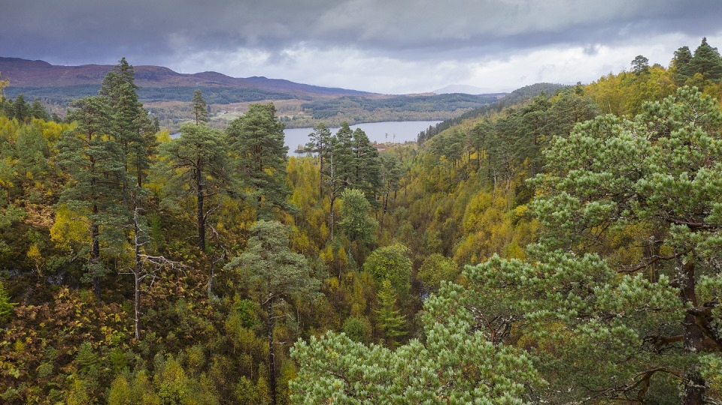
Restoring Biosphere
Vitality
+
Thriving
Within Planetary
Boundaries
Sustainable Development
GHGs
Notes:
A lot of talk and energy is focused on GHG emission. They are important, no doubt. However, sustainable development is an even wider topic encompassing all 17 Sustainable Development Goals.
We can’t simply sustain current impacts on the environment. Thus, the most important topic to discuss is restoring biosphere vitality and thriving within planetary boundaries. We live in a limited system, yet behave as if never-ending growth can be accommodated. Not with current practices.’
Do you think that the amount of damage we are causing to the environment, or the efficiency with which we use resources are at a level we wish to sustain?
There are still 0.8 bln people who still lack access to energy. There are billions that still lack access to clean drinking water or basic sanitation or to the internet. We must balance raising the level of development and access we provide to developing countries, all while radically reducing GHGs and impact on the environment.

Slide 6
NEXT GEN WINNING LEADERSHIP STACK

Slide 7
We
need
Change Makers
Movement Builders
Notes:
We need to build two key capabilities in our members
We need people who are able to catalyse change at scale, and build and nurture movements. In Gaia we say we must, “Think like activists and act like engineers.”
Additionally, we need effective communicators who are brave enough to engage with the public to explain our industries central role to helping drive the energy transition.
Our industry is seen as a single monolithic industry. We’re all lumped together as one entity. Yet, we don’t show up to the public with aligned messaging. We don’t effectively collaborate and integrate. We lack a sense of aggregation, and as such, we do ourselves a great disservice.

Slide 8
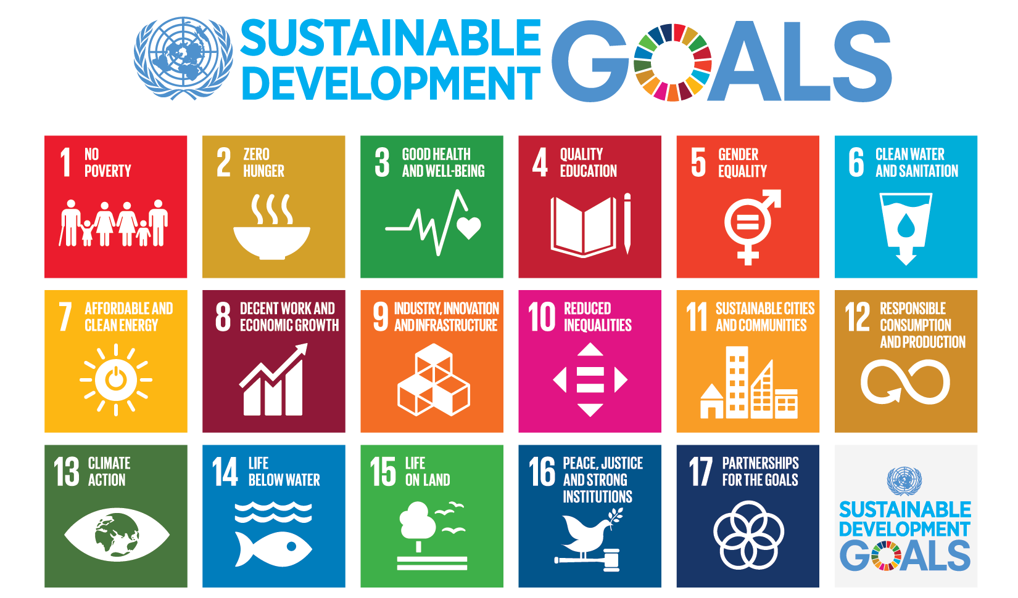
Notes:
Our industry plays important roles in every one of the 17 UN SDG’s. Learn about them and learn how you can contribute in your daily work and decisions.
If you look at any one in isolation, you’re missing the point. They’re all inter-related.
If you haven’t looked at it already, I recommend reviewing the IPEICA Sustainability Atlas that links the SDG’s with actions we can take in the O&G industry to support those goals: More information: www.sdg-roadmap.org

Slide 9
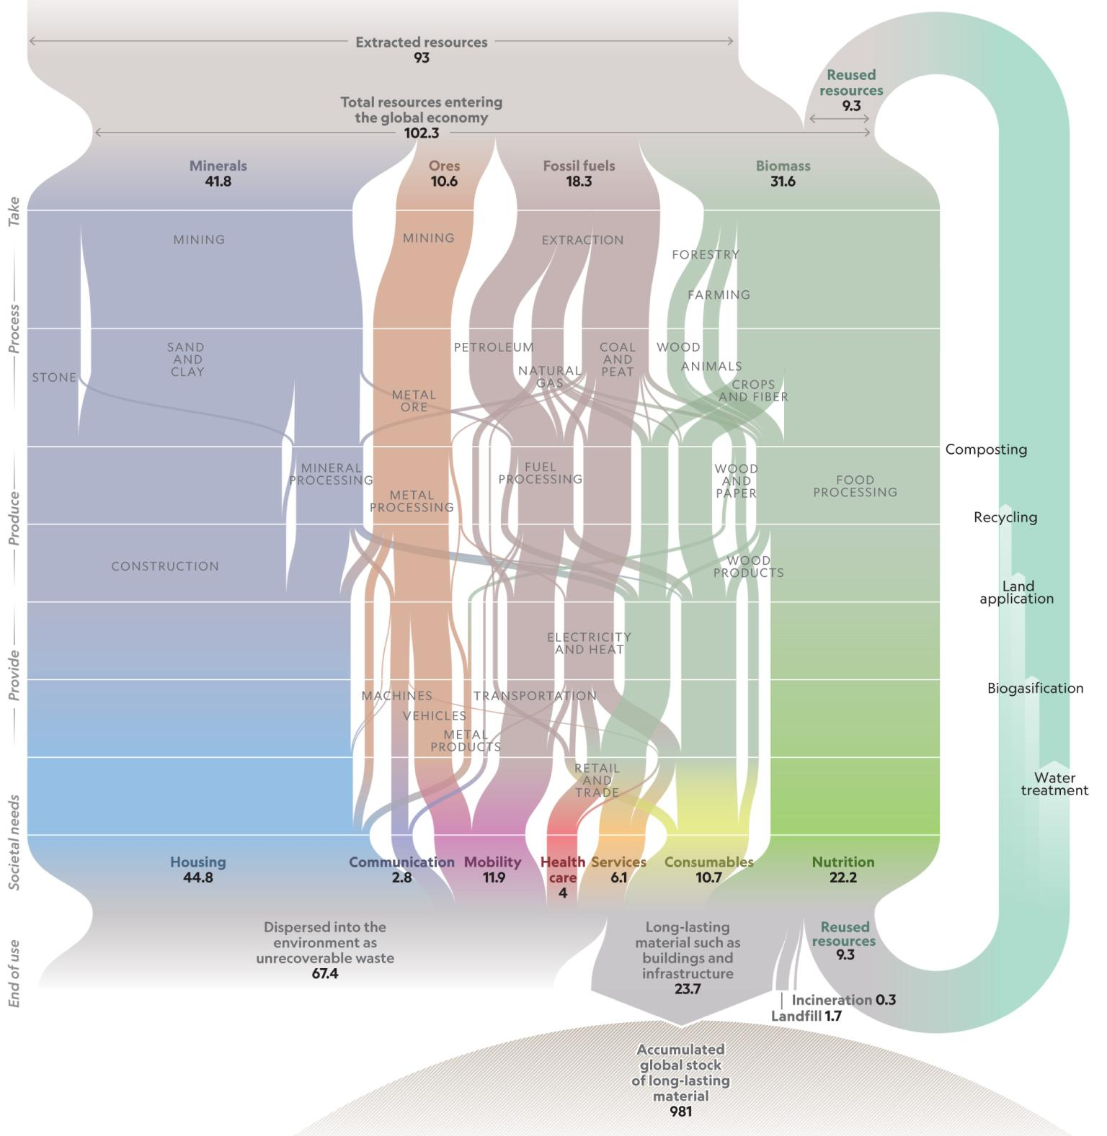
Only 10%
of our extracted resources are reused
On pace to triple material extraction in 30 yrs and triple waste prod. by 2100
SOURCE: graphic - https://www.nationalgeographic.com/magazine/2020/03/how-a-circular-economy-could-save-the-world-feature/
Waste stats: https://amp-theguardian-com.cdn.ampproject.org/c/s/amp.theguardian.com/cities/2020/jan/13/the-case-for-never-demolishing-another-building
Notes:
Every year 93 gigatons of material is extracted from the natural environment. We extract minerals, ores, fossil fuels, biomass
You can follow these down into the services they provide, like housing, communications, mobility, healthcare, service, consumables, nutrition
Some of this ends up as long-lasting materials for buildings and infrastructure.
Roughly 2/3 is dispersed into the environment as unrecoverable waste, like in landfills.
Only some 10% is reused.
The problem isn’t that we don’t have enough natural resources. The problem is that we’re incredible wasteful and inefficient in our use of these resources.

Slide 10
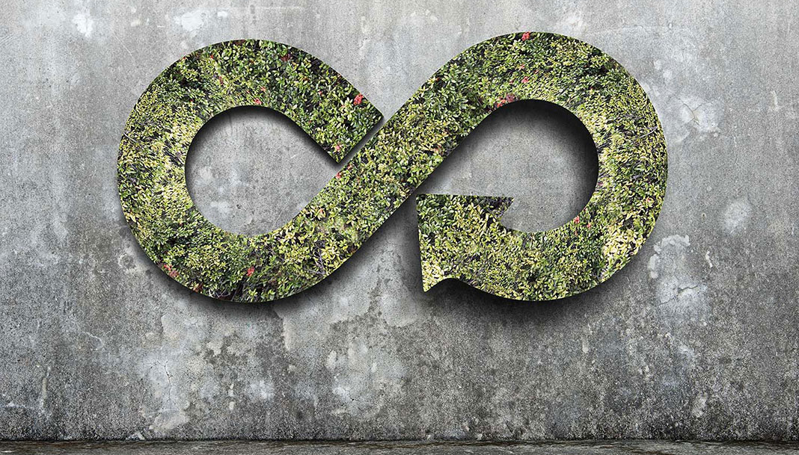
What will it take to close the loop?
Think about everything you saw or touched today
Now imagine re-using it rather than discarding it when it’s current use is finished
Notes:
The billionaires of the future are those who will look at today’s waste streams and see cheap feedstock to other value adding product and service production. The circular economy is not just a moral imperative, it’s a HUGE opportunity.
- For example: We must reimagine buildings as “urban mines’ of potential
“The moral argument simply doesn’t work,” says Rau. “We have to organise our thinking along the financial axis.” He calculates that, on average, the residual value of a building’s materials equates to around 18% of the original construction cost – a huge bonus to the bottom line, considering clients are usually saddled with the cost of disposing of demolition waste, rather than reaping any reward from it. “We have to show that materials are a valuable asset, rather than an expense to be lumbered with.”
SOURCE: https://amp-theguardian-com.cdn.ampproject.org/c/s/amp.theguardian.com/cities/2020/jan/13/the-case-for-never-demolishing-another-building

Slide 11
The New ‘Leadership Stack’
Disruptive creative innovators inspired by nature,
Collaborators;
Molecules & Electron energy pathways
Vision + Delivery, Systems thinkers inside Planetary Boundaries, Curious, Passionate Change Agents
Energy Transition
Sustainability
New Leaders Needed
Business Translators, Agile developers, data and code savvy,
Augmented by AI
Digital Transformation
Customer-focused Empathetic communicators,
Stakeholder inclusion
License to Operate
Notes:
That brings us to the new ‘leadership stack’ needed for the next generation of changemakers.
We need disruptive innovators to crack the energy transition, innovating across molecules and electrons, leaders who can drive deep collaboration
Leaders who make all business decisions with sustainability considered in addition to profitability. This requires leaders with both vision and the ability to deliver on that vision. It calls for systems thinkers and passionate change agents.
In order to protect and grow our license to operate as an industry, we need customer focused empathetic communicators that include stakeholders at all project stages.
Additionally, given the rate of change of digital transformation, leaders must be well versed in how digital can serve as an enabler. They must be able to translate business needs into a problem statement and set of technical requirements that a digital team can deliver against. They must be well-versed in agile development and the utilization of AI to augment human workers.

Slide 12
INTRO TO GAIA

Slide 13
The History of Sustainability as an SPE Discipline
From Externally-Driven to a Business-Driven Source of Pride
Sustainability award approved
Proposal—Gaia Summit
Measuring What Matters
Climate Strategy implemented
3 Distingished Lecturers
MOU IOGP & IPIECA
Webinar Program
20HSE & ATCE
Gaia Incubation
Tech Sections SD integration
GCS Energy Dot
3 DLS
3 Climate & ET Workshops
Gaia Summit Oman, LATAM, EU Students
ATCE
Gaia Talks [global & regional]
TREE program
DL program
IPTC
Engineering Solutions for Sustainability Workshop in Lausanne AIST with SPE
Sustainability standing committee formed
JPT President’s editorial
Webinar series
Board approves sustainability definition
Proposal to develop sustainability training program for members
Sustainability PetroTalks at HSSE-SR conference
Sustainability speaker roster
New subcommittees on “Metrics that Matter” and “Citizen Engineer”
2010–2012
2014
2016
2018
2020
2022
2013
2015
2017
2019
2021
First Sustainability Panel at ATCE
Task force on sustainability formed
Two day training program on Sustainability Imperative developed
Sustainable Development Technical Section formed
Three workshops on sustainability
Sustainability Imperative training
French Section conference on climate change
Climate change strategy approved
Gaia Summit
19ATCE
Bahrain Energy Summit
GCS EnergyDot
External Engagement
Sustainability Award
1 DL
Gaia Launch & Deployment
~ 40 Gaia Talks
11 Climate & ET Workshops – Gaia-enabled
21ATCE, 21OTC, Energy Dot
YP Congress -
JPT Decarbonisation Edition
Climate DL
Source: Johana Dunlop, HSES TD, 2017-2020
Notes:
Just skip quickly - point is to show that SPE has been leading and proactive on sustainability topics for over ten years because it is the only multidisciplinary professional society in the industry – this is a significant strength. The HSES discipline members include leading sustainability practitioners with extensive networks who can help members of others SPE disciplines move their comfort boundaries further out.

Slide 14
Leading With Purpose
The SPE Gaia Sustainability Program:
Helps align us on a vision of humanity learning to operate within planetary boundaries
Scales efforts that rise to the scale of urgency of the planet’s sustainability challenges
Builds on members’ core and transferrable skills
Provides a safe space for learning and engagement
Demonstrates O&G is critical and will lead a just energy transition that also expands access to energy
Embraces new bodies of knowledge
Provides a means to aggregate and align actions to accelerate the construction of a resilient, sustainable future energy system
Unifying Brand
Strategic Programming Framework
Ecosystem of Aligned Actors
Notes:
Gaia is a brand, an ecosystem and a strategic programming framework that can be adopted by all sections, chapters, committees and events in SPE. It might look like one size fits all but actually inside there is plenty of room for creativity and customization to audience. The thing to never lose sight of is the external context – the ecological thresholds and the social foundations which are both under threat from human activity and which we can help address.
The rationale for Gaia is explained in three parts – read from slide the key elements
Although we are all volunteers and goal setting is not typical we have set ourselves some aspirations as typically we do all like to have goals in our industry. We thought of the first year as one where we would try to get everyone on the same page so that in year two – 2022 – we could focus on Actions - our own via SPE but more importantly our own in the roles we fulfil inside our companies - how will be reframe our roles, how can we perform them differently, how can we enable others to embrace the energy system transformation so we can become the linchpin of this new system.
By year three we hope to have shattered the sustainability glass floor – removed all the barriers that today make it so challenging for operations to adopt sustainability aligned practices. We expect them to make the top line, make the bottom line, not hurt anyone and then save the planet at lunch time. There are paradoxical injuctions and a pressure on time that belies the complexity of execution to create the energy system transformation as well as transform humanity’s linear consumption models to circular economy models where waste no longer exists but becomes feedstock generating value.

Slide 15
Serving our community
Connect you with a community of dynamic technical professionals committed to the oil and gas industry and to thriving and operating within planetary boundaries.
Connect you to top quality events and content to accelerate your learning & professional growth
Gain a sense whether our industry is “doing enough, fast enough”
Join a bottom-up movement to shatter the “sustainability glass floor” to support operations & R&D in operationalizing the UN SDGs
Prove through collective action and real progress that our industry can be trusted to lead in the energy transition
A safe space for confident collective engagement among diverse view holders hosted in SPE event venues
Notes:
No need for script – all is on slide

Slide 16
9 Element Strategic Programming Framework Engaging and empowering engineers and scientists to generate scale and act with urgency & purpose
Notes:
Our framework started with 16 elements, then 12 and we distilled it down to 9 key and we hope memorable elements
The first three elements are about the quality and ambition of our actions. No ticking boxes but rather looking to move needles, to focus on our energy on where our strengths can have the greatest additional impact.
We identified three principles – Aggregation – so important in our complex value chain held together by contracts that leads to so much fragmentation. Fragmentation is our enemy. Each gap can have a wedge driven through it. The world sees us as ONE industry yet we don’t act like one. The idea here is to foster Aggregation and challenge ourselves to overcome anything that undermines it – tackling uncomfortable subjects, including stakeholders who don’t like us, learning to be comfortable with discomfort.
We have two other Principles – Collaboration and Engagement. We already do lots of both as an industry but do we do enough to be consistent with the scale and urgency of the challenges. If not then we have to up to our game.
The other six elements are divided in to Pathways and Priorities. The Pathway draw on SPE strengths – our technical excellence, our knowledge sharing mission, our multidisciplinary make up, our love of technology…………….so naturally Innovation is at the top, then Measuring what Matters where we believe we can contribute to the development of standardized fit-for-decision data to support sustainability aligned decision by Operations and by R&D the two key functions delivering the future energy system and any other sustainability aligned activity. Finally we have Listening and Communicating and here the thought is that our 100+ international events and 1000+ local events can be venues for diverse stakeholders to attend and debate and knowledge share for the benefit of all. The Priorities are about what the external world is worried about and on which we can have a significant impact.
Above all we want to encourage “thinking like activists, and acting like engineers”………….
This programming framework can underpin programming of any physical and virtual events – either stand-alone Gaia events or classic events with Gaia tracks or Gaia-enabled e.g. a CCUS technical workshop that also addresses stakeholder concerns.

Slide 17
SPE Gaia Sustainability – “moving needles, not ticking boxes” engaging and empowering engineers and scientists to generate scale and act with urgency and purpose
Energy System Transformation
Optimizing mix of hydrocarbons and alternative sources of energy to enable an inclusive transition towards net zero emissions in line with COP 21 targets.
Natural Capital & Regeneration
Employ natural capital to protect and regenerate raw stocks aided by technology and partnerships to create circular, carbon neutral/negative value chains. Learn the benefits of nature and its ecosystem services. Includes Gaia TREE program.
Social Responsibilities
In-country value, Just Transition, Diversity & Inclusion, Community Investment, Safety & Well-being at work; Systems Thinking; Circular Economy business models
A Programming Framework for Success
PRIORITIES
Planning Gaia co-branded events to engage and enable operations and R&D professionals in service of sustainable development and by extension our industry
Innovation in Energy
New markets, new business models, new techniques, new technologies, new processes, new mindsets to evolve a supply of energy that supports human activity inside planetary boundaries
Measuring What Matters
What data do operations and R&D need in order to prioritize and allocate resources to innovative sustainability performance factors. What does fit-for-decision sustainability performance data look like?
Listening & Communication
R&D is furthest from the external stakeholders and yet may have the greatest opportunity to ensure our technologies and techniques take their concerns into account and built trust through technical knowledge sharing.
Innovation
Natural capital and regenerative approaches include Biomimicry, CO2 capture and other nature based solutions, distributed ledger, as well as value chain transformation and enhancements
Measuring What Matters
Applying our knowledge of data science and engineering to development or improvement of nature-based solutions and the quantification of natural capital.
Listening & Communication
Foster multi-stakeholder engagements to learn about and share best in class natural capital and regenerative practices
Innovation
Encourage a culture of innovation with regard to sustainable development opportunities - circular economy business models; just practices; stakeholder engagement; local development; collaboration; mindfulness and systems thinking; safety and well-being at work
Measuring What Matters
Not everything that matters can be counted – foster learning that helps business integrate the difficult to measure in ways that systematically integrate the practice of managing externalities
Listening & Communication
Create conditions for trust and success by scaling mastery of techniques of stakeholder engagement through our events and publications. Encourage study of connections between engineering and ethics, philosophy and social sciences.
1
PRIORITIES
Top sustainable development priorities related to our industry – in focus
2
PATHWAYS
PATHWAYS – SPE STRENGHTS
Select one, two or all pathways for your program architecture. The Gaia pathways are those most aligned with SPE strengths thus providing the most additional and highly leveraged ways of progressing sustainability practices in our industry.
3
PRINCIPLES
Aggregation
Avoid fragmentation in efforts, create an aggregated view through applying this unifying brand, disciplined use of this strategic framework and mobilization of our ecosystem of future makers, through our events and publications.
Each event should adhere to all three principles. Use them to create strategic programming and to guide quality, relevance, reach and scale of your events and publications.
Engagement
Engage internal and external stakeholders to cultivate trust through technical knowledge sharing. Cultivate challenging exchanges and produce surprising solutions.
Collaboration
Collaborate with others to execute ambitions aligned with the scale and urgency of the challenges of operating business and sustaining quality of life that remains inside planetary boundaries.
PRINCIPLES
Notes:
This is the expanded version of the framework and is not for presenting but more for consulting by those in charge of programming

Slide 18
3-year goals: Gaia programming framework in action
2023: “Shatter the sustainability glass floor”
Raise recognition that the O&G industry has a central role to play leading the energy transition
See evidence of our strategic and additional impact on the industry
Shatter the sustainability glass floor that separates top-down efforts from the core of the industry
Ecosystem and repository of bottom-up innovations and practices manifested in SPE event programming, OnePetro papers, discipline White Papers, SPE Live events, etc.
2022: “Moving needles, not just ticking boxes”
Create a Safe Space to bring the outside in, learn, extend our comfort zone, and grow
Create flagship events that deploy SPE strengths in producing “additional “contributions to strong sustainability performance by the industry.
Bring knowledge back into our companies, align ambitions, embed into innovation and operations
Help industry professionals upskill to find their role in contributing to the energy system transformation
2021: “Empowering our members”
Build sustainability fluency and foster agency among members – start bottom-up movement in service of sustainable development
Disseminate top-down sustainability efforts of associations and companies
Start to crack the “sustainability glass floor” [c] and accelerate operations uptake
Help industry navigate toward future energy system – integrated, clean, inclusive with O&G as linchpin

Slide 19
2019/2020 – Initiation and Scaling
Initiation at 2019 Gaia Summit in Fontainebleau, France
Refined and tested framework in action
Integrated Gaia in Sustainable Development Technical Section as flagship program
SPE Gaia community on Linked In [>900 members]
30+ presentations int. & ext.
10 International Gaia Talks
14 Section Gaia Talks
OGCI Methane e- Series – 5 SPE Live webinars
Gaia-enabled 11 SPE energy transition events
Climate/ET programming expert engagement series
Petrobowl questions
Supported BML re Sustainability Leadership training
Shared & engaged with SEG and AAPG

Slide 20
2021 – Empowering our members
Launched in all 7 Regions and implemented model to support scaling – key Sections launched
Convened a great team – operational & directional – and growing
Resources in Section Officers Resource Center
Created SPE TREE brand & implementation guide to support Sections & Chapters
SPE Live & Sections– 20+ Gaia Talks and workshop webinars with OGCI, IPIECA, IOGP, IOGCCC: Themes:
Energy System Transformation [COP 26, CCUS, Methane, etc.]
Natural Capital
Just Transition
Measuring what Matters
Indigenous Wisdom
YP Congress Measuring what Matters – Expert Engagement, JPT Article
Methane Discussion Group – launched with PFC, Completions & DSEA
Events: Hydrogen Workshop; Geothermal Workshop [Gaia-enabled]
Gaia on Linked In: almost 1,000 members

Slide 21
2022 – Moving needles, not just ticking boxes
Methane: Discussion Group → Technical Section; 10 JPT Articles; Methane Guiding Principles Supporting Organisation – proposal to July Board Meeting planned
CCUS Gaia Talks led by IPIECA with OGCI and IOGP
Other Gaia Talks: SPE Live & Section: Natural Capital; Just Transition; Indigenous Wisdom; Methane
ATCE 2022 – Gaia Special Sessions: Scope 3; Natural Capital; GAIA dinner with MEMRA & CCUS and guest speaker on CC Transportation & Storage
IPTC 2022 - Gaia Special Session led by YMEC on Carbon Circular Economy & Natural Capital
Regional Events : Oman Gaia Summit
SDTS & HFTS & BML: Collaboration around sustainability mindset
SDTS & BML: Sustainability training
Hydrogen Forum: Support/enable
Asia RD Forum: Support/enable
AAPG & SEG collaboration

Slide 22
2023 – Shatter the sustainability glass floor
Shatter the sustainability glass floor that separates top-down efforts from the core of the industry
Continue to provide useful resources and learning opportunities to support the frontline
What else? Where should we begin scoping and planning now for 2023 ambitions?
COP28 in UAE: SPE Present?
Annual Gaia Summit, rotating across regions, or summits in several regions per year?
OTC-style Gaia Conference with sister societies?
What would you propose we focus on?
Where would you like to engage to support?

Slide 23
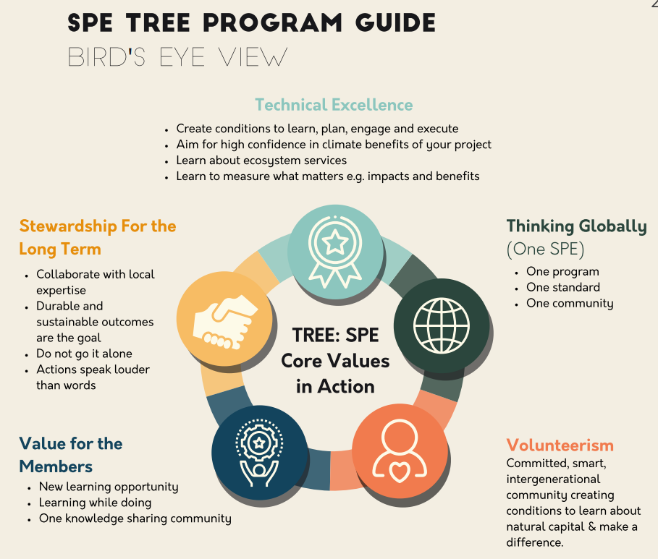
SPE TREE: Expert Resources at your Fingertips
A Nature-based solution
TREE: Together Reforest for Energy and Ecology – a guide to implement a very high standard of nature-based solutions to offset emissions
Builds on existing Section tree planting activities Steered by external biodiversity technical experts
TREE encourages the involvement of stakeholders and experts
Raises awareness of best practices for holistic ecosystem restoration
Notes:
One example of programming is our TREE initiative – under the Natural Capital and Regeneration priority.
The text covers all the talking points
Standing for Together Reforest for Energy and Ecology, TREE is an initiative under the SPE Gaia Sustainability program which aims for a very high standard in supporting or directly implementing nature-based solutions to offset emissions pending scaling of direct abatement and removal solutions.
TREE has been designed to embody the SPE core values: technical excellence, knowledge sharing, member engagement, and collaboration.
The TREE initiative builds on existing Section tree planting activities and provide all Sections and Chapters with a comprehensive technical guide to help define motivation and desired outcomes; to design project configurations including collaboration with external biodiversity technical experts and ensure oversight.
TREE encourages the involvement of stakeholders, local experts and other initiatives with a similar mission.
The TREE implementation guideline includes an extensive set of references to supporting learning about natural capital solutions best practices.
The emissions tracking start-up Footprint Inc. is a TREE partner to help Sections & Chapters determine their emissions offsetting rationale for their tree planting efforts e.g. Member personal emissions; % of country national emissions; % of industry emissions; % of events emissions etc etc

Slide 24
MEASURING WHAT MATTERS

Slide 25
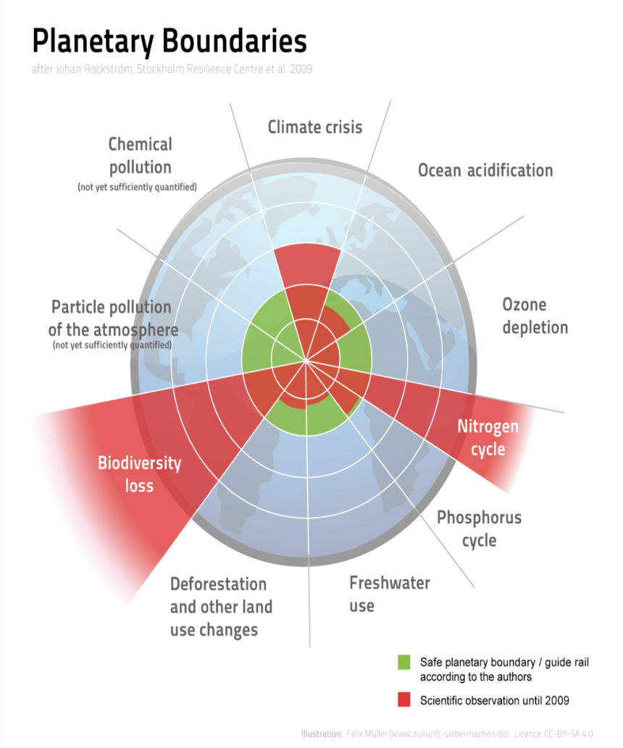
SPE Gaia Measuring What Matters
“You can’t manage what you don’t measure” - Peter Drucker
Consideration balanced across all 9 planetary boundaries
Biodiversity, natural capital (forests, water, ozone, oceans)
Pollution (particulates, chemicals, GHGs)
Natural cycles (nitrogen, phosphorus)
Intentional primary focus on largest, near-term lever well within the Oil & Gas industry control
Can you guess what that is?

Slide 26
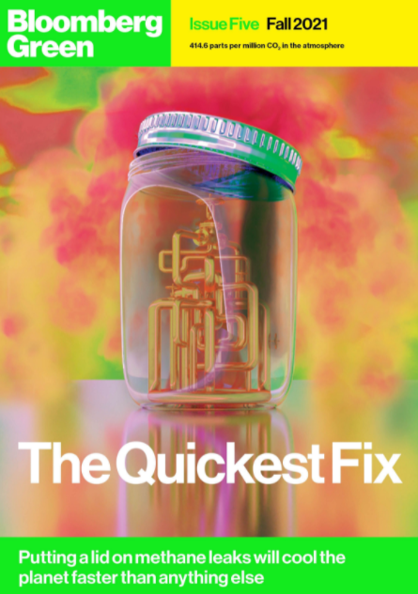
Why focus on methane?
Methane has contributed to around 30% of the global rise in temperatures to date
Curbing these emissions is the most effective means available for limiting global warming in the near term
Pathways to reduction are both clear and cost-effective
Fossil fuel operations generated close to 120 Mt of methane in 2020 – nearly one-third of all methane emissions from human activity
Possible to avoid more than 70% of current emissions with existing technology, 45% could be avoided at no net cost.
Source: https://www.iea.org/reports/curtailing-methane-emissions-from-fossil-fuel-operations/executive-summary

Slide 27
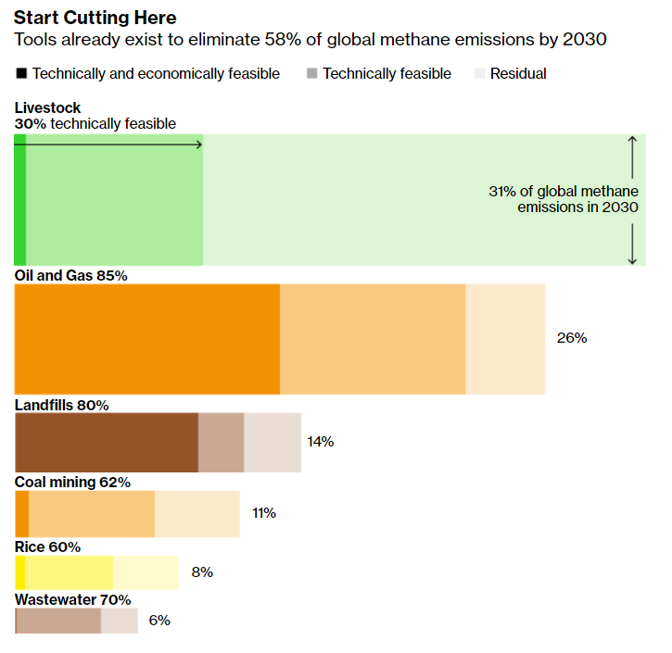
The Oil & Gas Industry’s Role
Source: https://www.bloomberg.com/graphics/2021-methane-impact-on-climate/?srnd=green

Slide 28
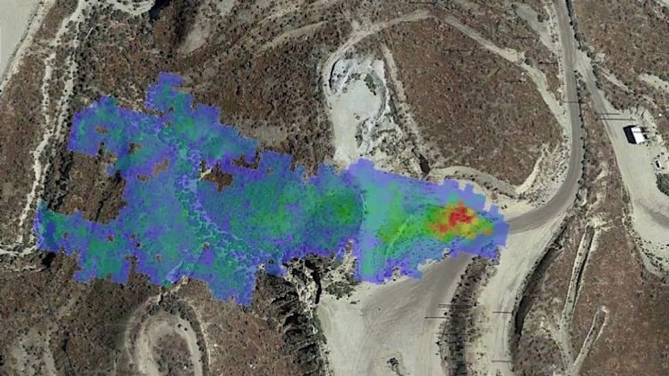
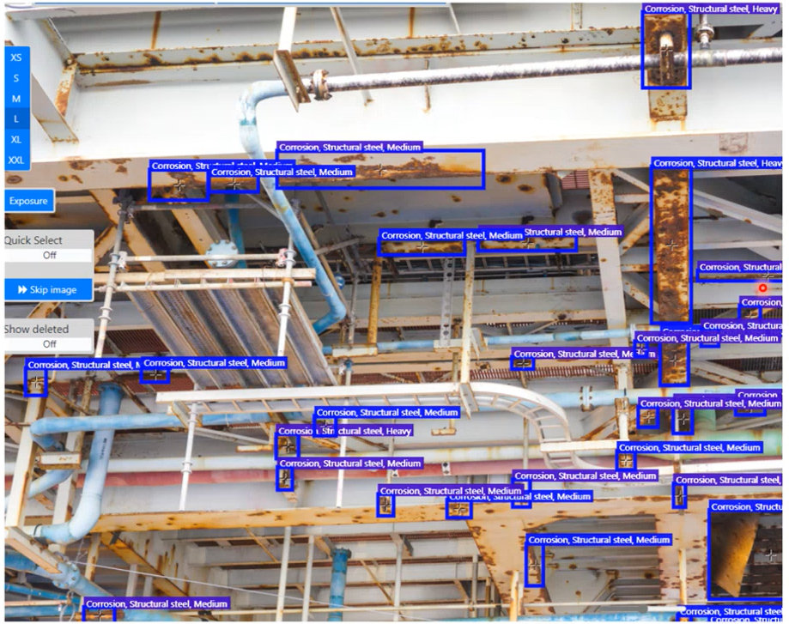
There for all to see
Image Credit: https://www.bbc.com/future/article/20210805-the-search-for-the-worlds-largest-methane-sources (NASA/JPL)

Slide 29
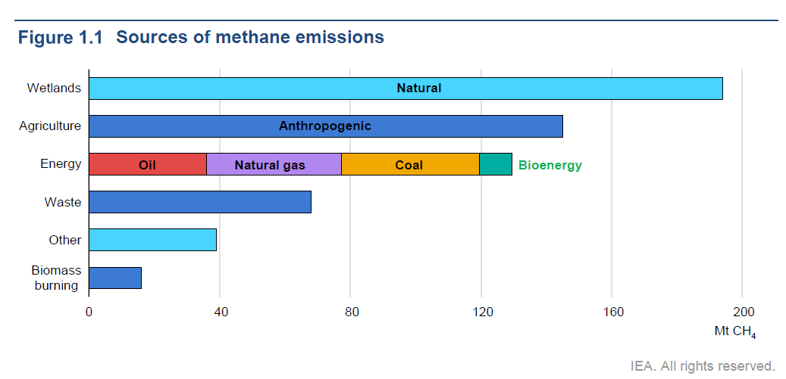
45% reduction of anthropogenic methane emissions by 2030 avoids 0.3 degC warming by 2040s
Notes:
The European Union and the United States have launched a landmark pledge to slash emissions of the powerful greenhouse gas methane, a commitment that could prevent 0.2 degrees Celsius of global warming. The alliance's members will seek to lower global emissions of methane — the second-largest contributor to climate change after carbon dioxide — by 30 percent below 2020 levels by 2030. Besides the EU and the U.S., more than 103 countries have signed up so far, including major methane emitters like Nigeria and Pakistan.

Slide 30
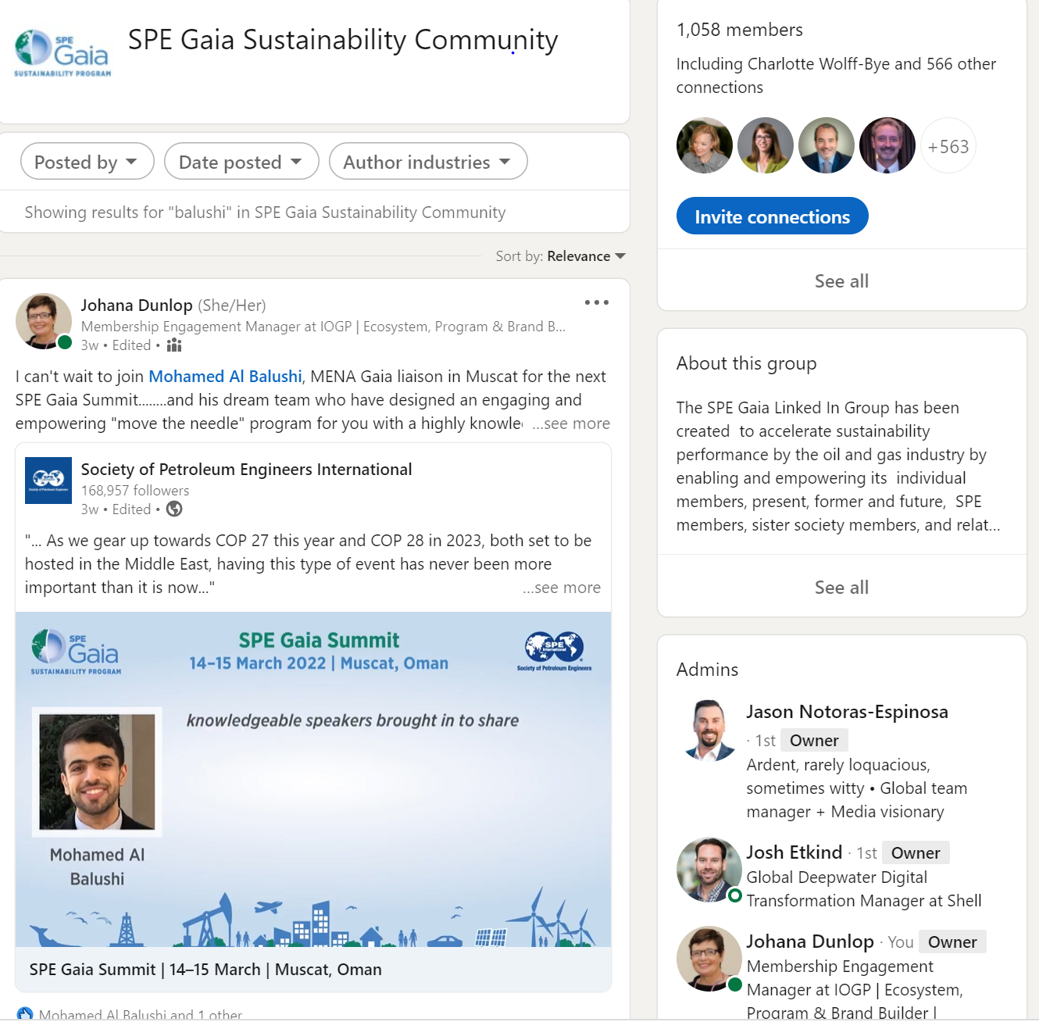
An inclusive, vibrant, and rapidly growing community – inside and outside the SPE!
Join the Sustainable Development Technical Section
+
The Gaia LinkedIn Community
+
Methane Discussion Group
Notes:
Join our Gaia Linked In Community https://www.linkedin.com/groups/12464854/
where expert curated content is posted every day and sometimes engages vigorous debate. It creates a sense of belonging and all Gaia programming is promoted to the members who are not all in oil and gas but are interested.
We accept anyone in oil and gas who is keen to learn and contribute to sustainability progress, anyone outside who has expertise we can learn from and who is willing to learn about the oil and gas industry, students from our SPE chapters and also AAPG and SEG and other societies. We turn down anyone who is not visibly connected to this growing community or connected to the challenges. We discourage job seeking and service selling and do not permit attacking language.

Slide 31
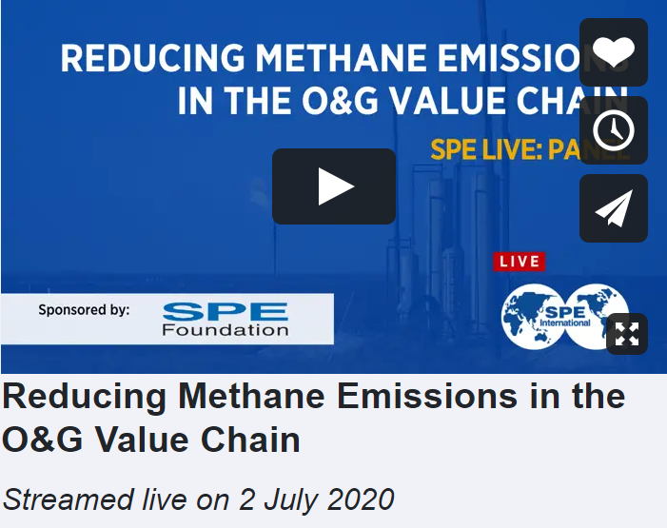
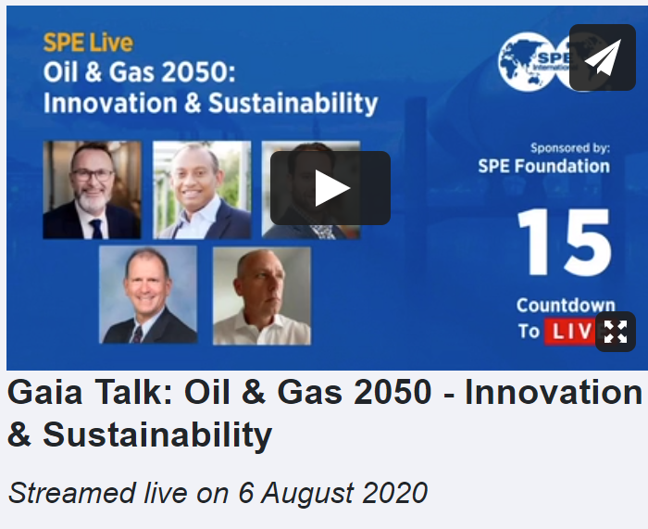
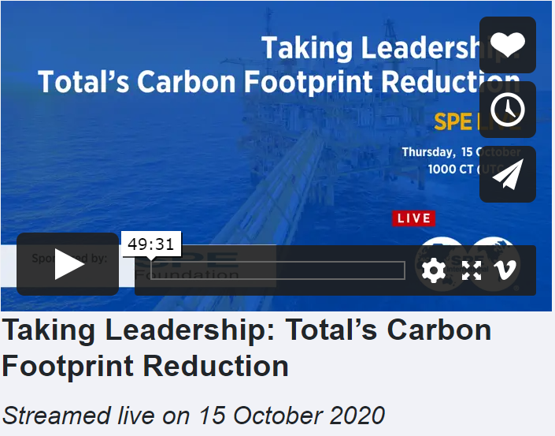
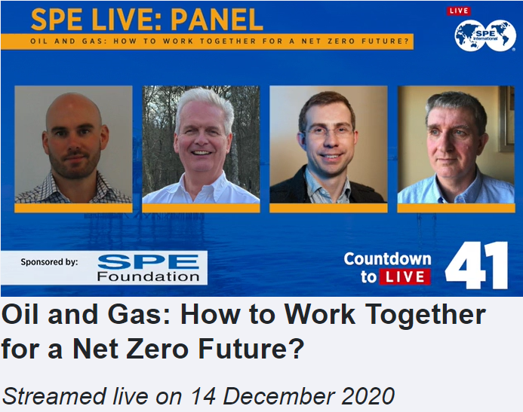
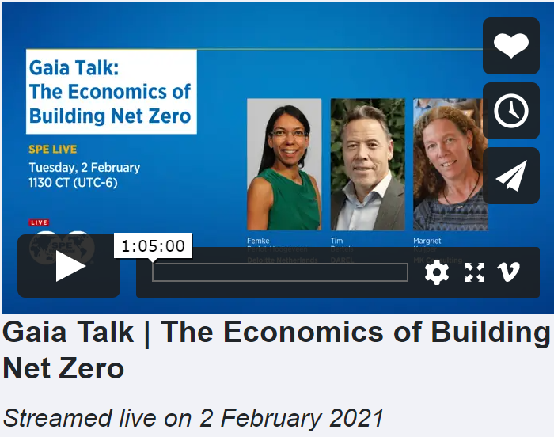
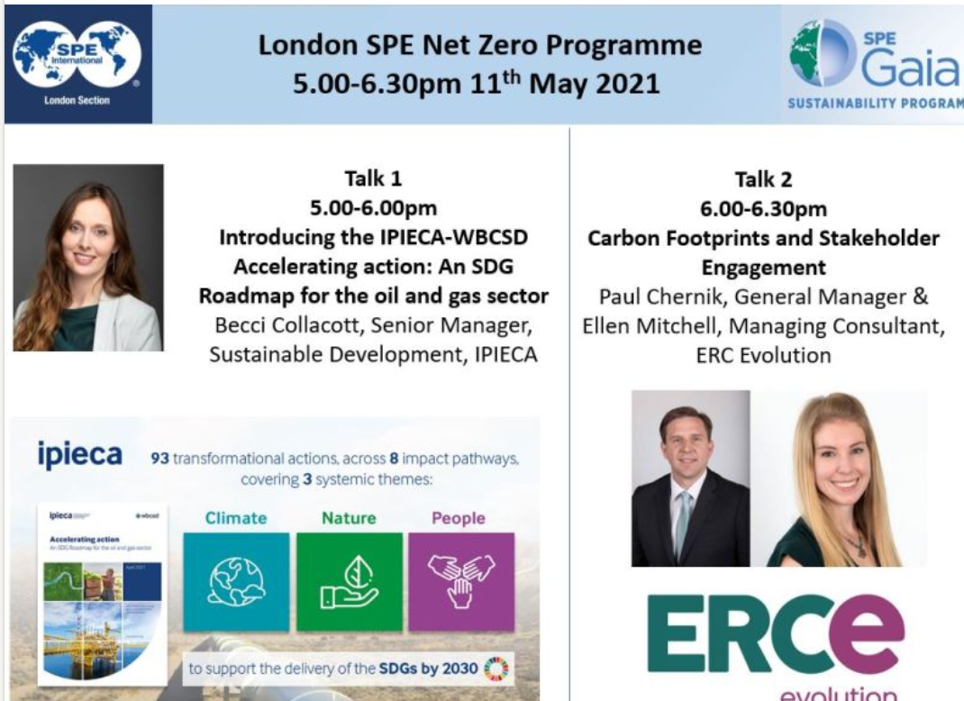
Gaia Talks – an on-demand library for members
SPE Live
Podcasts
e-Sessions
Firesides
See a listing of all Gaia Talks events here: https://streaming.spe.org/?s=gaia
Notes:
Gaia Talks are a key programming feature – global Gaia Talks on SPE Live and local Gaia Talks organised by Sections often working together on themes, speakers, overall coherence etc
Many Gaia Talks are galvanized by the Gaia Regional liaisons and their teams of highly motivated individuals

Slide 32
Gaia Resources
Gaia LinkedIn Community: https://www.linkedin.com/groups/12464854/
Sustainable Development TS: https://connect.spe.org/sdts/home
Gaia Talks: https://streaming.spe.org/?s=gaia https://www.spe.org/en/events/live-events/
Gaia Digital Assets: https://spe.widencollective.com/c/2bnv38at
Gaia Hub: https://www.spe.org/en/gaia/
Notes:
These links will take you to the key Gaia resources

Slide 33
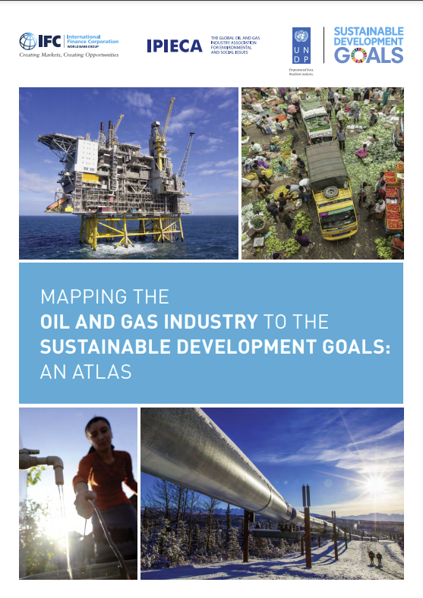
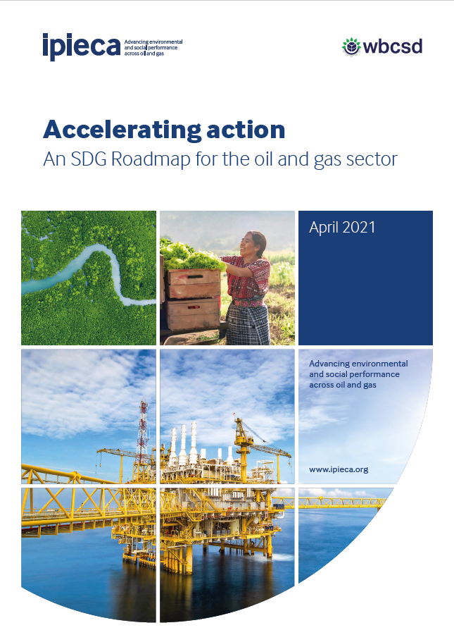
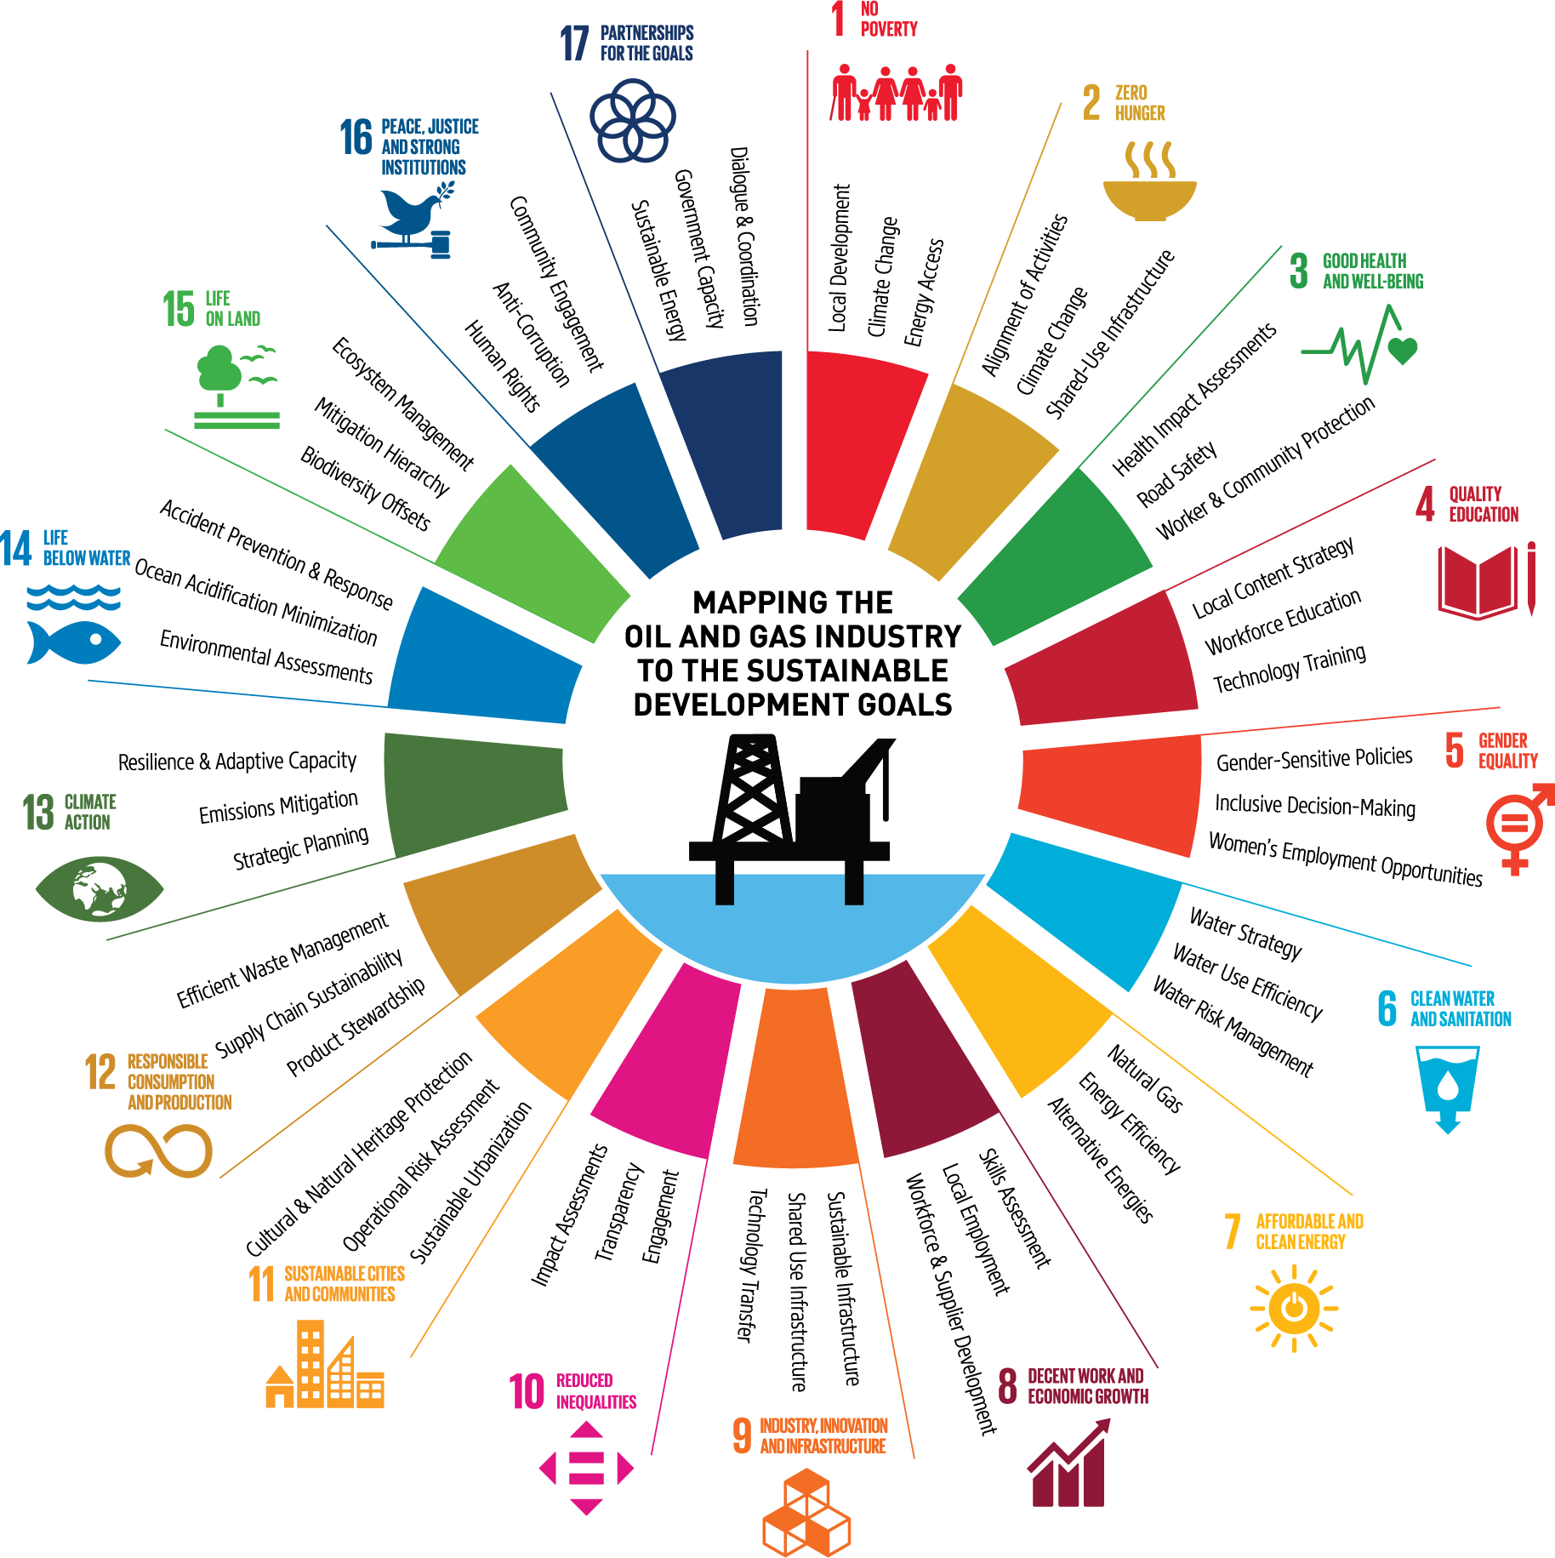
The oil and gas industry and the SDGs
Accelerating action
Example of top-down industry association best practices to support scaling
The Roadmap (2021) builds on the foundations of the SDG Atlas by presenting a series of impact opportunities which focus on where the sector can maximise its contributions to the SDGs
The SDG Atlas (2017) provides an overview of how the oil and gas sector interacts and contributes to all 17 SDGs
More information: www.sdg-roadmap.org
Notes:
Here you can see the cover of the actual report.
We are glad to have the opportunity to partner with WBCSD in this project who are well positioned through their work with other sectors to produce Roadmaps and gave us good steer throughout the project.
This Roadmap is really about lifting our Atlas we put together on the next level and really concentrate on concrete actions our industry can conduct to contribute to the SDGs. Of course nothing mandatory as every company has different business models, is operating in different regions etc.
As we rapidly approach the 2030 deadline to deliver the UN Sustainable Development Goals (SDGs), the need for concerted action and coordinated solutions involving all parts of society is more urgent than ever.
But it’s really about inspiring the sector to contribute to the SDGs.

Slide 34
us
“Give me a place to stand, and a lever long enough, and I will move the world. ”
— Archimedes
we
Notes:
Thank you for your attention. I hope we can exchange on the ideas we are presenting here. The SPE is very determined to make this new initiative a success and in supporting the members of the Gaia community, perhaps it’s even a movement already, in reaching optimal impact.
And staying with the Ancient Greeks who taught us much and for whom Gaia was the personification of Mother Earth I will close with a slight variation on the quote from the great Ancient Greek scientist Archimedes where we changed the “I” to a “we”. “Give us a place to stand, and a lever long enough, and we will move the world” – “place to stand” being the SPE, the “lever” being the Gaia program and the “we” being all the SPE members and near-members committed the oil and gas industry being part of the solution to global warming and biodiversity collapse.

Slide 35
JOIN US!
Notes:
Thank you for your attention. I hope we can exchange on the ideas we are presenting here. The SPE is very determined to make this new initiative a success and in supporting the members of the Gaia community, perhaps it’s even a movement already, in reaching optimal impact.
And staying with the Ancient Greeks who taught us much and for whom Gaia was the personification of Mother Earth I will close with a slight variation on the quote from the great Ancient Greek scientist Archimedes where we changed the “I” to a “we”. “Give us a place to stand, and a lever long enough, and we will move the world” – “place to stand” being the SPE, the “lever” being the Gaia program and the “we” being all the SPE members and near-members committed the oil and gas industry being part of the solution to global warming and biodiversity collapse.

